Slide 1
Collections and Streaming
Notes drawn from: http://www.oracle.com/technetwork/articles/java/ma14-java-se-8-streams-2177646.html

Slide 2
An example: get all grocery transactions, sort them, return list of transaction IDs
List<Transaction> groceryTransactions = new ArrayList<>();
for(Transaction t: transactions){
if(t.getType() == Transaction.GROCERY)
groceryTransactions.add(t);
}
Collections.sort(groceryTransactions, new Comparator(){
public int compare(Transaction t1, Transaction t2){
return t2.getValue().compareTo(t1.getValue());
}});
List<Integer> transactionIds = new ArrayList<>();
for (Transaction t: groceryTransactions)
transactionsIds.add(t.getId());
Notes:
Rewrite this using Lambda expressions (but not streams!)

Slide 3
Now using Streams…
List<Integer> transactionsIds =
transactions.stream()
.filter(t->t.getType() == Transaction.GROCERY)
.sorted(Comparator.comparing(Transaction::getValue).reversed())
.map(Transaction::getId)
.collect(Collectors.toList());

Slide 4
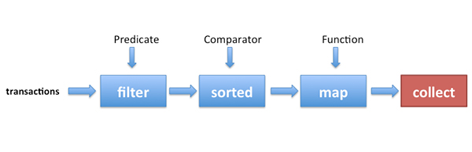
Stream Pipeline

Slide 5
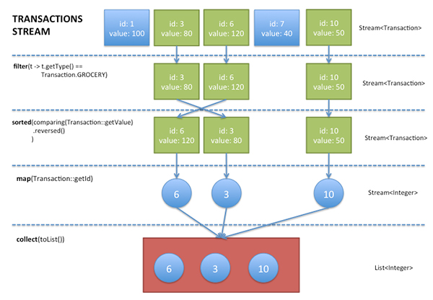

Slide 6
Parallelizing the code
Replacing stream() with parallelStream() allows the JVM to take advantage of the multiple cores on your computer

Slide 7
Aggregate Operations
Streams support SQL-like operations such as filter, map, reduce, find, match, sorted, etc
Many of these operations return a stream themselves allowing the operations to be chained into a larger pipeline
Streams are iterated for you

Slide 8
Some operations explained
Stream() – streams from the source collection
Filter – filter elements given a predicate
Sorted – sort based on a comparator
Map – extract information
Collect – (does NOT return a stream), returns a result (e.g. a new list)

Slide 9
Intermediate vs terminal operations
Intermediate operations (filter, sorted, map) return a stream and can be connected together to form a pipeline
Operations that close a stream pipeline are called terminal operations and produce a result from a pipeline such as List, Integer, void etc
Intermediate operations are “lazy” ie. They produce nothing until a terminal operation is invoked on the stream.
Intermediate operations can therefore usually be merged and processed into a single pass by the terminal operation

Slide 10
List<Integer> numbers = Arrays.asList(1,2,3,4,5,6,7,8);
List<Integer> twoEvenSquares =
numbers.stream()
.filter(n->{ System.out.println("filtering "+n);
return n % 2 == 0;});
.map(n-> { System.out.println("mapping " + n);
return n * n;})
.limit(2)
.collect(Collectors.toList());
Output:
Filtering 1
Filtering 2
Mapping 2
Filtering 3
Filtering 4
Mapping 4
Notes:
The limit(2) returns a stream of size 2 to collect() [first 2 elements to meet the filter requirement]. Thus not all elements are processed in the stream. Also filter() and map() have been merged into the same pass (i.e. as we filter each element, those that pass are moved onto the map() for processing)

Slide 11
Streaming Operations

Slide 12
Filtering
filter(predicate): takes a predicate as an argument and returns a stream including all elements that match the given predicate (java.util.function.Predicate)
distinct: returns a stream with unique elements according to element.equals()
Limit(n): returns a stream that is no longer than size n
Skip(n): returns a stream with first n number of elements discarded
anyMatch, allMatch, noneMatch: takes a predicate and returns boolean (terminating operations)

Slide 13
Mapping
Mapping(function): takes a function to project the elements to another form. java.util.function.Function
Function<T,R>: element type, return type
Any lambda function that follows the function definition. E.g. map(String::length)

Slide 14
Function - Reduce
Reduce(initial value, BinaryOperand<T>): applies the binary operand to the elements returning the value
A simple non-stream sum of numbers:
int sum = 0;
for(int x: numbers)
sum +=x;
Using reduce in streams:
int sum = numbers.stream().reduce(0,(a,b)->a+b);
Reduce(<init value>, <repeating function>)
Note: primitives are “wrapped”

Slide 15
mapTo…()
Primitives are “wrapped” and unwrapped for operations
To improve performance using specialized map functions to create a special stream
mapToInt(), mapToLong(), mapToDouble()
int sumTransactions = .stream() .mapToInt(Transactions::getValue)
.sum()

Slide 16
Building Streams
Streams can not only come from Collections but also from values, an array, file or even a use a function to generate them
Stream<Integer> numbersFromValues = Stream.of(1, 2, 3, 4);
int[] numbers = {1, 2, 3, 4};
IntStream numbersFromArray = Arrays.stream(numbers);
Two methods Stream.iterate and Stream.generate allow you to create a stream from a function. As they are calculated on demand they can produce infinite streams
Stream<Integer> numbers = Stream.iterate(0, n -> n + 10);

